Slide 1
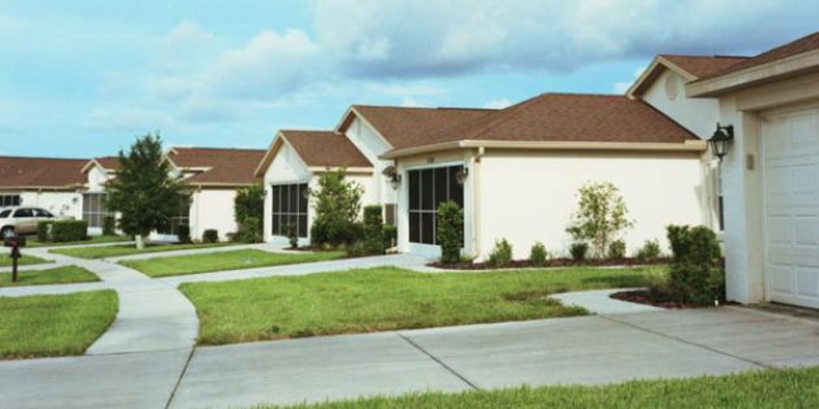
Housing Market
US Housing market descriptive analytics
Sai Prasanth

Slide 2

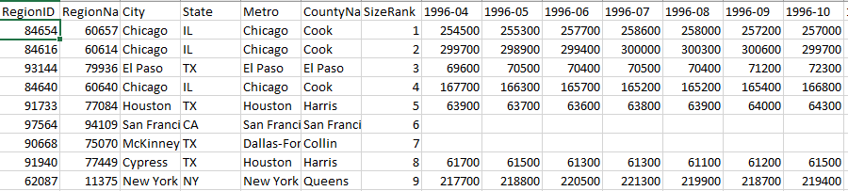
Zillow home prices and rents
●https://www.zillow.com/research/data/
●Home prices and rents of all popular zip codes in USA
●20 files, 10 MB

Slide 3
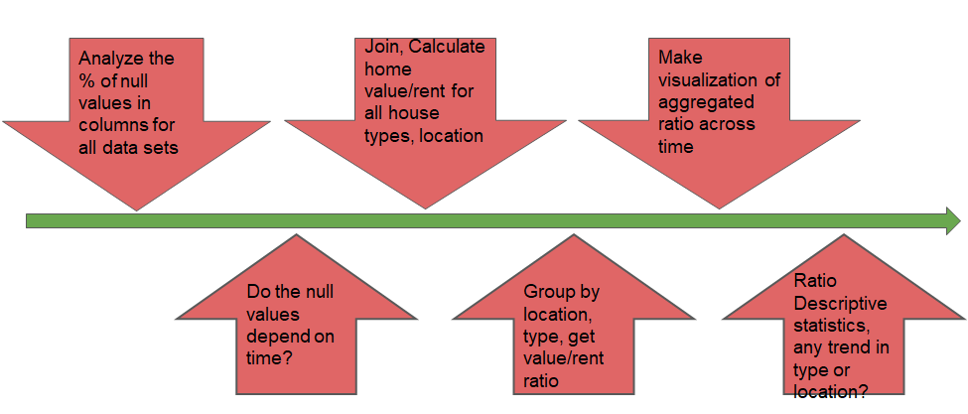
Data Analysis Plan

Slide 4
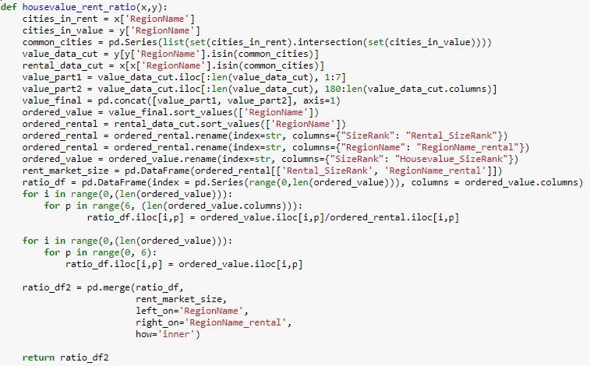
Wrangle 1

Slide 5
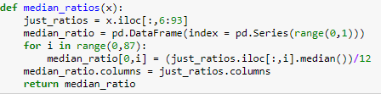

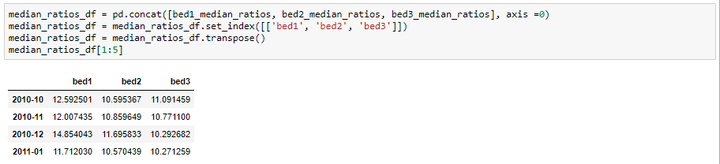
Wrangle 2

Slide 6
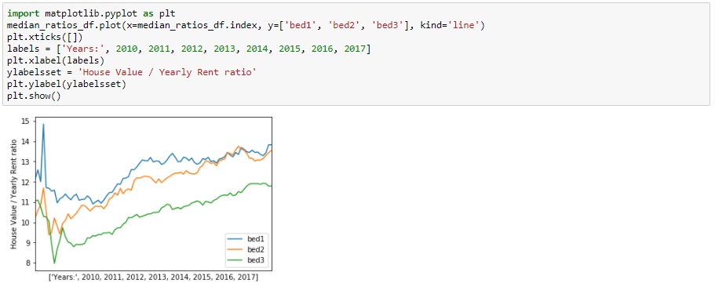
Conclusion

